Slide 1

Full Stack Development with Java (ID201B) Even Semester Session 2024-25 Payment Gateway
Group Members:
Nilesh Agrahari (202410116100134)
Nishant Raikwar (202410116100135)
Preet Kumar (202410116100147)
Rabita Yadav (202410116100156)
Project Supervisor:
Dr. Vipin Kumar
Associate Professor

Slide 2
Content
Introduction
Problem Statement
Project Objectives
Technology Stack
System Architecture
Modules
Workflow
Challenges & Solutions
Future Scope
Conclusion
Notes:
Font Styles: Times New Roman + Font Size: 25

Slide 3
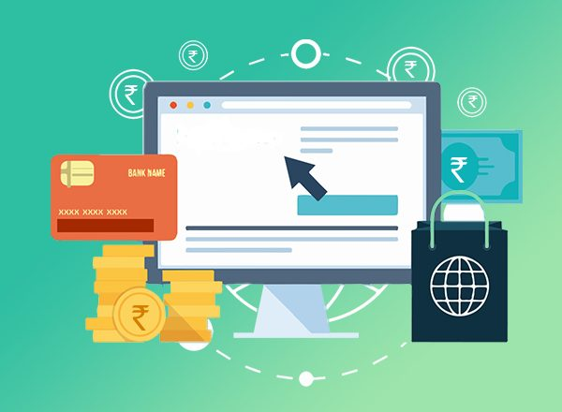
Introduction
What is a Payment Gateway?
A payment gateway is a technology that allows users to make online payments securely.
It acts as a bridge between the customer, merchant, and bank, ensuring transactions are processed safely.
Why is it Important?
Ensures secure online transactions.
Facilitates cashless payments for e-commerce and services.
Reduces the risk of fraud and data breaches.
Notes:
Font Styles: Times New Roman + Font Size: 25

Slide 4
Problem Statement
Traditional payment methods (cash, bank transfers) are slow and inconvenient.
Many businesses face challenges in integrating online payment systems.
Security threats like fraud, hacking, and data leaks are increasing.
Notes:
Font Styles: Times New Roman + Font Size: 25

Slide 5
Project Objectives
Develop a secure and efficient payment gateway.
Integrate with APIs like Razorpay, Stripe, PhonePay etc.
Provide real-time transaction tracking.
Implement error handling for failed transactions.
Ensure data security and encryption.
Notes:
Font Styles: Times New Roman + Font Size: 25

Slide 6
Technology Stack
HARDWARE REQUIEMENTS
SOFTWARE REQUIREMENTS
Operating System : Windows 10 (later)
UI Technology : HTML, CSS, JS, BOOTSTRAP,
RAM : min 2 GB
Back-end : DJANGO
(Python Framework)
Hard Disk Space : min 20 GB
API Integration : Strip / RazorPay / phonePay / others
Processor : core i3(or higher)
Database : SQLlite
Notes:
Font Styles: Times New Roman + Font Size: 25

Slide 7
System Architecture
User initiates a payment request
Payment API processes the request
Transaction is verified and approved by the bank
Response sent back to the user (Success/Failure)
Notes:
Font Styles: Times New Roman + Font Size: 25

Slide 8
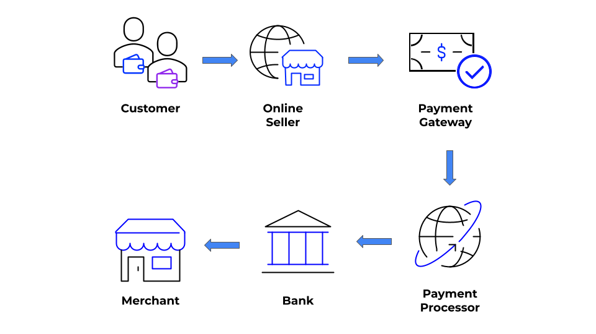
Notes:
Font Styles: Times New Roman + Font Size: 25

Slide 9
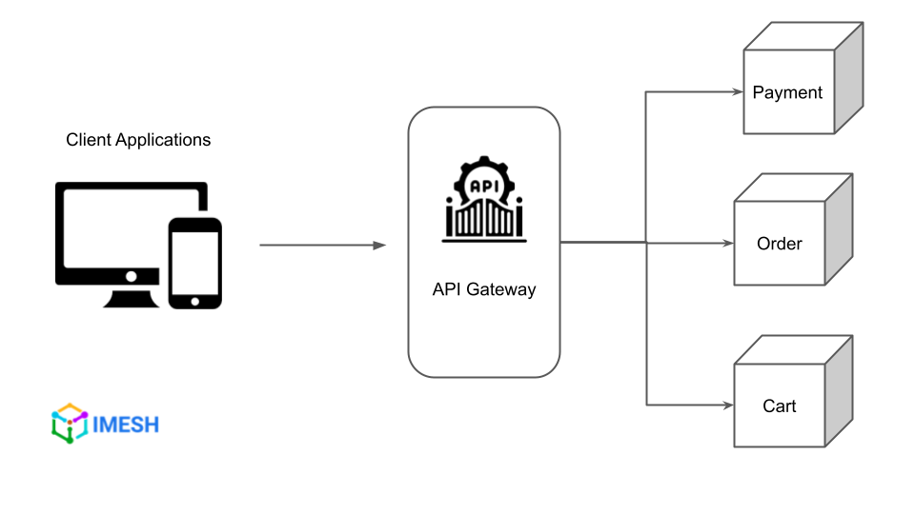
Notes:
Font Styles: Times New Roman + Font Size: 25

Slide 10
Modules
Product Module 🛍️
Manages the products/services available for purchase.
Allows users to browse, select, and add items to their cart.
Stores product details, pricing, and availability.
Ensures a smooth shopping experience before payment processing.
Notes:
Font Styles: Times New Roman + Font Size: 25

Slide 11
Modules
2. Payment Module 💳 (Using API)
Integrates with third-party APIs like Razorpay, Stripe, PhonePay for transaction handling.
Encrypts and securely transfers payment details to the payment provider.
Handles authorization, authentication, and fraud detection before confirming transactions.
Sends success/failure notifications to users and merchants.
Notes:
Font Styles: Times New Roman + Font Size: 25

Slide 12
Modules
3. Order Module 📦
Manages order placement, tracking, and history.
Stores order details, payment status, and delivery information.
Updates the order status based on payment confirmation from the payment module.
Provides users with real-time tracking of their purchases.
Notes:
Font Styles: Times New Roman + Font Size: 25

Slide 13

Workflow
DESIGN PHASE
IMPLEMENTATION PHASE
Entity Relationship Diagram
Data Flow Diagram
Data Structure
TESTING & DEPLOYMENT PHASE
Database Development
Back-End Development
Front-End Development
Unit Testing
System Testing
Deployment
Notes:
Font Styles: Times New Roman + Font Size: 25

Slide 14
Challenges & Solutions
Challenge 1: API Latency Issues
Solution: Optimize API calls & use caching mechanisms.
Challenge 2: Handling Failed Transactions
Solution: Implement retry logic & notify users properly.
Challenge 3: Security Risks
Solution: Use SSL encryption, tokenization, and secure API keys.
Notes:
Font Styles: Times New Roman + Font Size: 25

Slide 15
Future Scope
Multi-Currency Support for global transactions.
AI-based Fraud Detection to prevent suspicious transactions.
Mobile App Integration for a seamless user experience.
Advanced Analytics Dashboard for tracking user payments.
Notes:
Font Styles: Times New Roman + Font Size: 25

Slide 16
Conclusion
Successfully built a secure and efficient payment gateway using DjangoAPIs.
Ensured fast transaction processing and real-time tracking.
Implemented security measures to prevent fraud.
Future improvements include AI fraud detection and multi-currency support.
Notes:
Font Styles: Times New Roman + Font Size: 25

